Slide 1

NETW 191
Lyndsey Spears
March 2022 session

Slide 2
Introduction
Network
Satellite
Link
Implemented an IPv4 addressing scheme and network support
Test the connectivity among the two computers and SOHO Router
Class C network and divide its block of IP Address and configure two loopback interfaces on the SOHO router
Create a network diagram that depicts the interconnection of the Computer 1 VM, the Computer 2 VM, and the SOHO Router VM

Slide 3

Ipv4 Addressing
Default gateway
IPv4 addressing

Slide 4


Preparation
This screenshot shows the terminal window that shows the default gateway IP address.

Slide 5
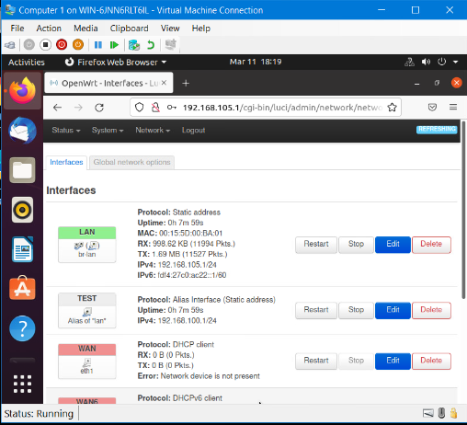
IPv4 Address Assignment
This screenshot shows the Interfaces page that shows the new IPv4 address on the LAN interface.

Slide 6
Connectivity Test Template Submission
Dynamic IP addressing for Computer 1 and Computer 2
Connectivity test between Computer 1 and Computer 2

Slide 7
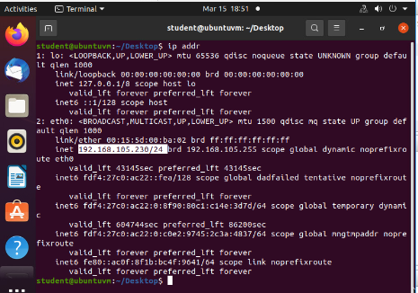
Dynamic IP Address Assignment
This screenshot should show the IPv4 address of the Computer 1 VM.

Slide 8

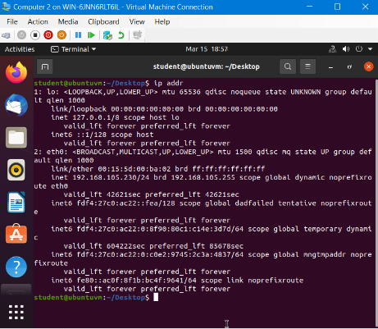
Dynamic IP Address Assignment
This screenshot should show the IPv4 address of the Computer 2 VM.

Slide 9

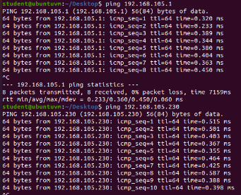
Connectivity Test
This screenshot should show the connectivity tests between the Computer 1 VM and the other two devices (i.e., the SOHO Router VM and Computer 2 VM).

Slide 10
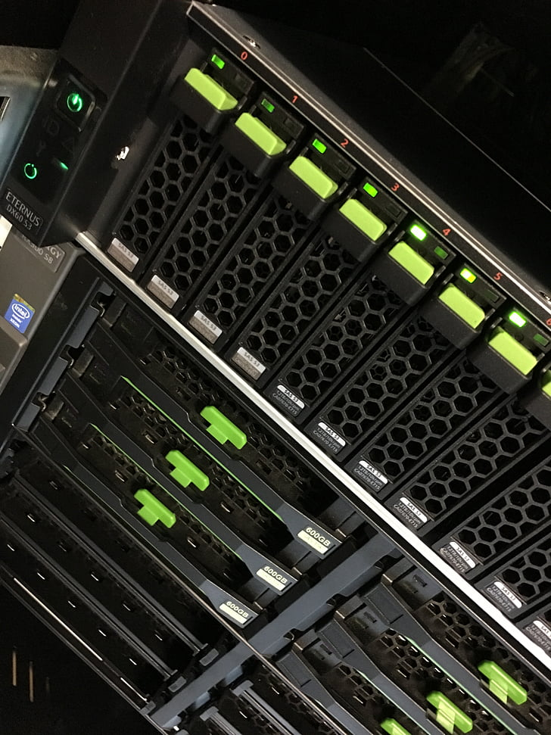
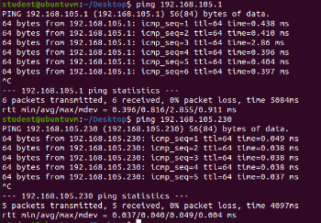
Connectivity Test
This screenshot should show the connectivity tests between the Computer 2 VM and the other two devices (i.e., the SOHO Router VM and Computer 1 VM).

Slide 11
IP Subnetting and Loopback Interfaces
Subnetting
Loopback Interfaces
Connectivity test

Slide 12

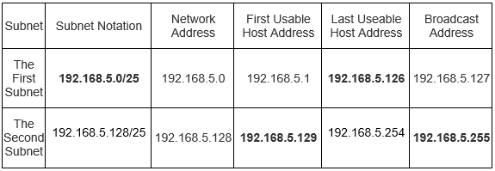
Subnetting Table
This table should include two /25 subnets, listing the subnet notation, network address, first usable host address, last usable host address, and broadcast address of each subnet.

Slide 13

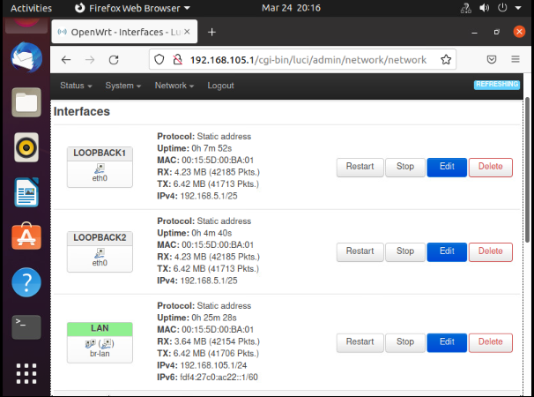
Loopback Interfaces
This screenshot should show both Loopback1 and Loopback2 interfaces and their correct IPv4 addresses.

Slide 14

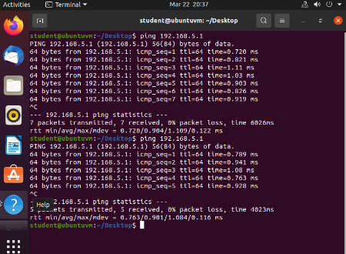
Connectivity Tests
This screenshot should show two successful ping tests from the Computer 1 VM to the Loopback 1 and Loopback 2 interfaces.

Slide 15
Visio Network Diagram
Microsoft Visio network diagram that depicts the interconnection of computer 1 and computer 2

Slide 16
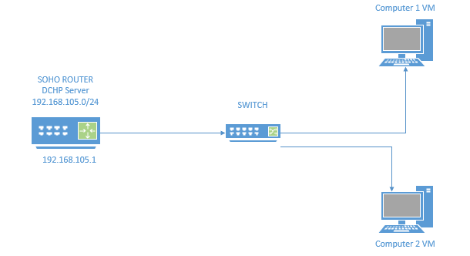
Microsoft Visio Network Diagram
This diagram should illustrate the interconnection of the Computer 1 VM, the Computer 2 VM, and the SOHO Router VM.

Slide 17
SOHO Wireless Network Security
Security
LAN wireless
Router configurations

Slide 18

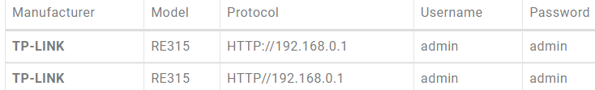
SOHO Wireless Network Security
1. What are the factory default username and password of a TP-Link router? Why is it important to change the default username and password of a SOHO router?
Answer: Below is screenshots of the username and password. The reason it is important to change the default username and password of a SOHO router is that it is easier for hackers to access the network in a second as the password is well-known and easy to access.
2. To protect a SOHO wireless network with a small number of devices, which address management method provides more control, configuring the device IP addresses manually (static IP) or using a DHCP server (dynamic IP)? Why?
Answer: Based on the reading it looks like the DHCP server (dynamic IP) is a more preferred method. Being so it is much easier to manage and is much cheaper to deploy than a static IP. Also, with a DHCP server, you can reserve IP addresses and modify them much easier than a static IP.
3. What does MAC filtering do? If needed, when would you use deny filtering rules and when would you use allow filtering rules? What happens to devices that want to connect, if the “Allow the stations specified by any enabled entries in the list to access” function is enabled but there are no entries in the list?
Answer: MAC filtering allows you to control the wireless stations accessing the AP, which depends on the station’s MAC addresses. Depending on the security or access settings for the router would determine when to deny filtering rules and when to allow set filtering rules to occur. If the “allow stations are specified but the enable function has no entries, then this means there is no wireless stations that can access the AP.

Slide 19

SOHO Wireless Network Security
1. What wireless security settings are displayed on the Wireless Security page? Which one is recommended by the vendor? Why?
Answer: There are four main types of security settings based on the wireless security page which are as followed: Disable Wireless Security, WPA/WPA2-Personal, WPA/WPA2-Enterprise, and WEP. The most common one that is recommended by the vendor is the WPA/WPA2 – Enterprise since Enterprise authentication and TKIP encryption are not supported with WPS enabled and is strongly recommended to enable wireless security and select WPA2-PSK AES encryption.
2. Among the configurations you explored in this module, which one is a true security function? Why?
Answer: Based on the configurations that I have explored in this module is the WPA/WPA2 – Personal version. Even those this version has a lot of similarities to WPA/WPA2-Enterprise the personal version allows a user to customize their own set of security restrictions. For example, the option for encryption can be selected as either auto, TKIP, or AES. As well as modifying the wireless password.
3. What would you do to protect your wireless network at home? Why?
Answer: What I would protect my wireless network would be to use one of the security options that I have learned in this module such as the WPA/WPA2-personal due to the ability to modify certain restrictions for wireless access. As well as adding an additional layer of security by having a VPN (Virtual Private Network) included for extra security.

Slide 20

References
1. https://emulator.tp-link.com/902AC_US_Emulator/Emulator_Router/index.htm
2. https://www.routerpasswords.com/router-password/tp-link/

Slide 21

Challenges
Had issues with creating the subnet address
Creating a diagram showing the connectivity for Computer 1 and Computer 2
Setting up the connectivity between computer 1 and computer 2

Slide 22

Career skills
Communication skills
Create analytical skills
Ability to multitasks
Problem solving
Able to test connections between computers and help provide connections for companies

Slide 23
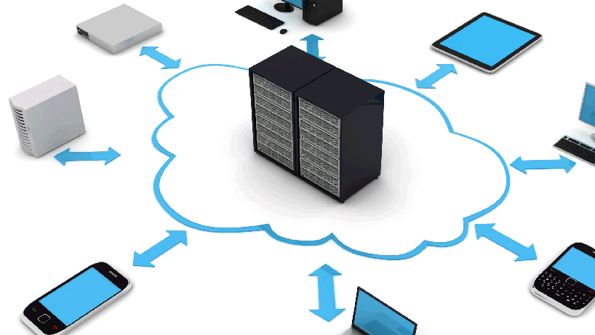
Conclusion
While working on this project I learned how to trouble shoot networking issues. By testing (ping) a device to make sure an establish connection is be done. Created a diagram to show how Computer 1 communicates to Computer 2. Also learned how to protect a network with a variety of security options.
This Photo by Unknown Author is licensed under CC BY-NC

